Slide 1

A course on Basic and Translational Immunology, with emphasis on immunologic diseases and therapeutic strategies
Abul K. Abbas, MD
University of California San Francisco
Developed as an education program of the Federation of Clinical Immunology Societies (FOCIS)
FOCiS

Slide 2
Themes of the course
The nomenclature of immunology
Basic principles: mechanisms underlying immune responses
Emerging concepts, and their potential clinical and therapeutic implications

Slide 3
What does the immune system do?
Normal functions
Defense against infections
Defense against some tumors
Disease and therapeutic implications
Cause of disease (autoimmunity, allergy)
Barrier to transplantation, gene therapy

Slide 4
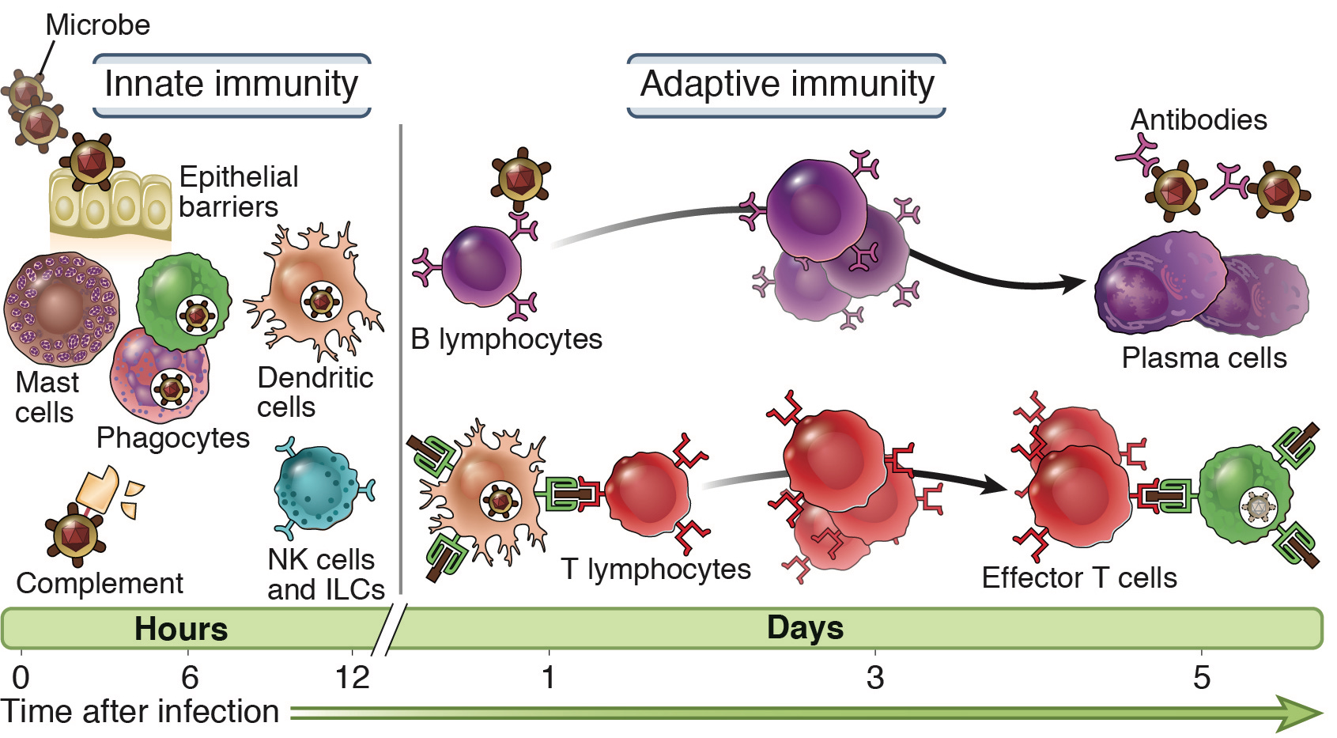
Innate and adaptive immunity
Abbas, Lichtman and Pillai. Basic Immunology, 5th edition, 2016, Elsevier
Innate immunity: always present (ready to attack); many pathogenic
microbes have evolved to resist innate immunity
Adaptive immunity: stimulated by exposure to microbe; more potent

Slide 5
5
Types of adaptive immunity
Different types
of immune
responses are
mediated by
different classes
of lymphocytes
and defend
against different
types of microbes

Slide 6
6
Cells of the immune system
Lymphocytes: the cells of adaptive immunity; recognize antigens and develop (differentiate) into cells that perform the defense functions
Antigen-presenting cells: cells that capture antigens and display them to lymphocytes
Effector cells: leukocytes (white blood cells) that eliminate microbes (the “effect” of the immune response); may be lymphocytes, but are often other leukocytes

Slide 7
Classes of lymphocytes
Antibody production
Cytokine secretion
Killing machinery
Suppression of immune responses
Abbas, Lichtman and Pillai. Cellular and Molecular Immunology, 9th edition, 2017

Slide 8
Lymphocyte diversity and clonal selection
8
Lymphocyte
precursor
Generation of mature lymphocytes with many different antigen receptors
Naïve lymphocytes circulate through lymphoid organs
Antigen X
Antigen Y
Specific lymphocytes recognize antigens
Lymphocytes are activated to proliferate and to differentiate into effector cells
Anti-X
antibody
Anti-Y
antibody
Lymphocytes with highly specific and diverse antigen receptors develop prior to exposure to antigens

Slide 9
9
Generation of diversity

Slide 10
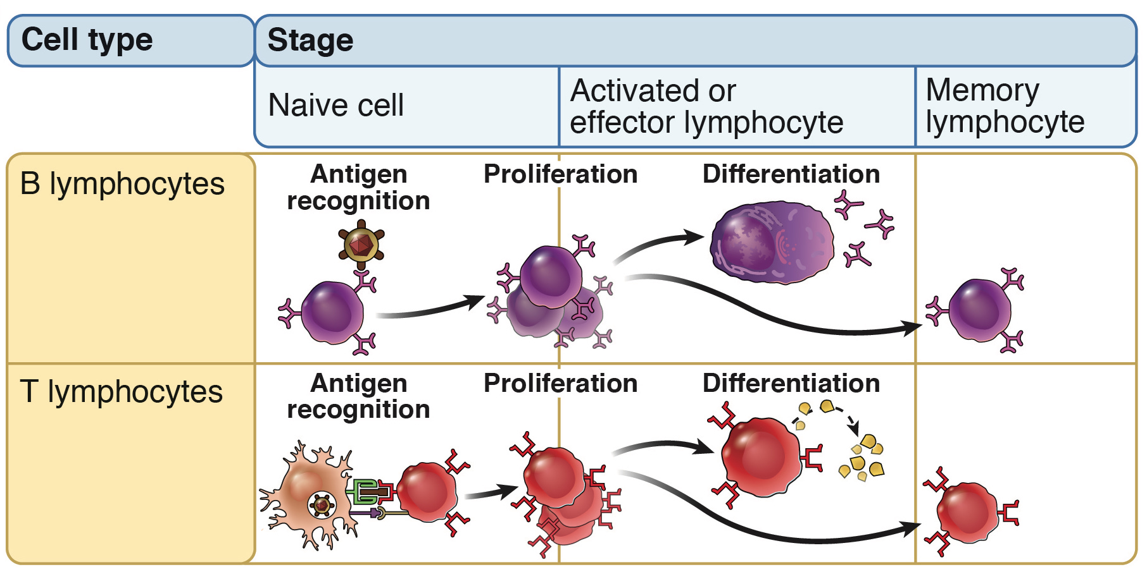
Stages in the life history of lymphocytes
Proliferation: expands number of antigen-specific cells Differentiation: converts lymphocytes into effective defenders

Slide 11
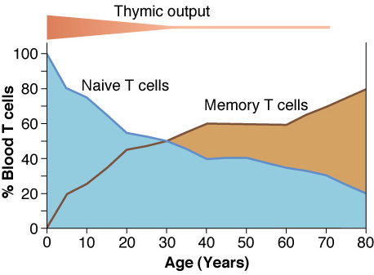
Accumulation of memory T cells with age

Slide 12
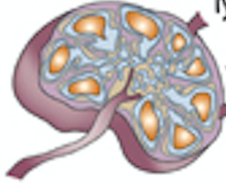

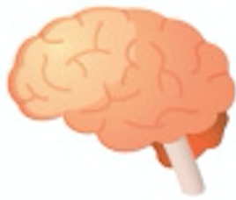
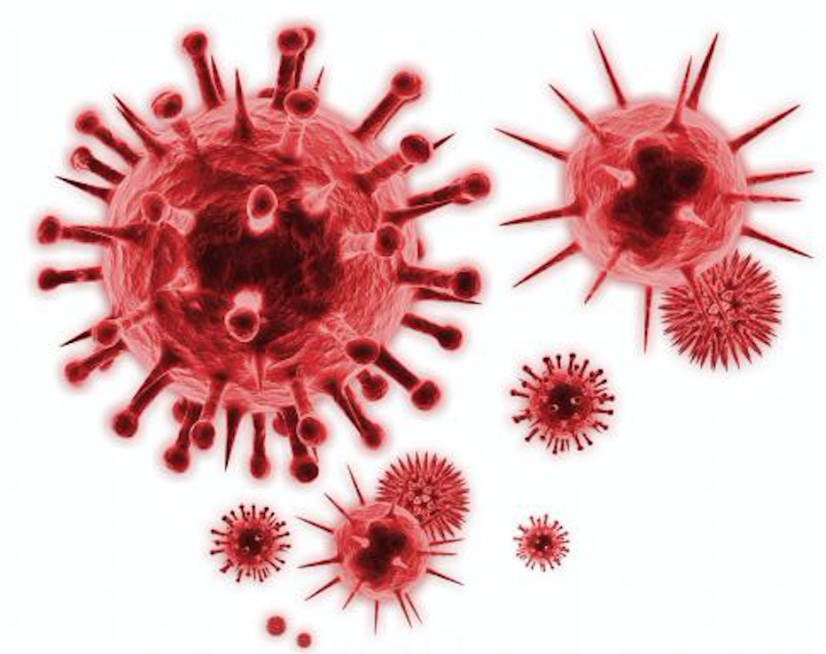
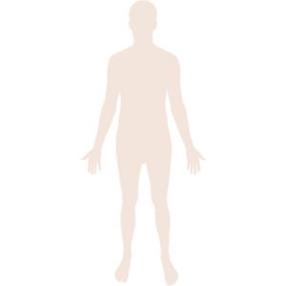

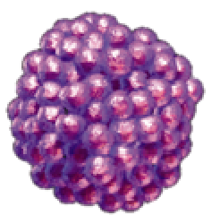
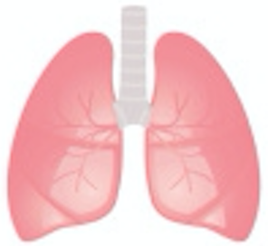
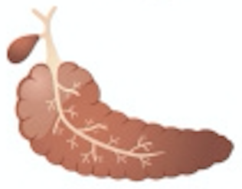
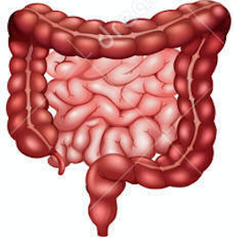
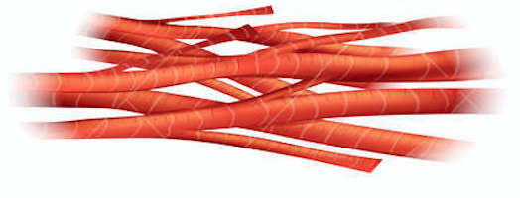
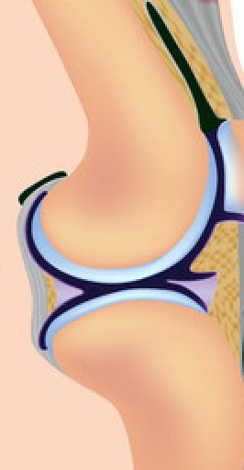
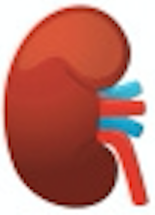
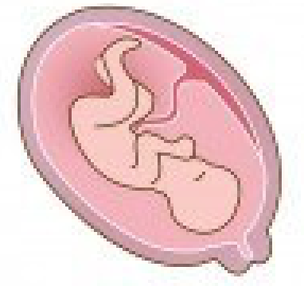

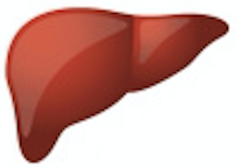
Immunological basis of human disease
Psychological Disorders
(Alzheimer’s, PTSD, depression, bipolar)
Immune deficiency
Cardiovascular Disease
(Atherosclerosis, hypertension, stroke)
Cancer
Allergy
Metabolic Disorders
(Diabetes, Fatty liver dis.)
Response
COPD
Tolerance
Autoimmunity
(T1D, MS, RA, IBD)
Muscular Dystrophy
Osteoporosis
Transplantation
Tolerance
Aging

Slide 13
The significance of recent advances
Provides a solid foundation of basic principles
Improved understanding of disease mechanisms
Development of novel therapies
Appreciation of the role of the immune system in non-immune diseases

Slide 14
Challenges in Immunology
Explosion of information creates complexity
  “Big data” is difficult to interpret, has not yet provided many useful answers
  Many complex cell populations and pathways
Translating results from mouse to human
  Co-housing with dirty mice makes the immune system of lab mice more like humans
Translating results from cell cultures to in vivo

