Slide 1
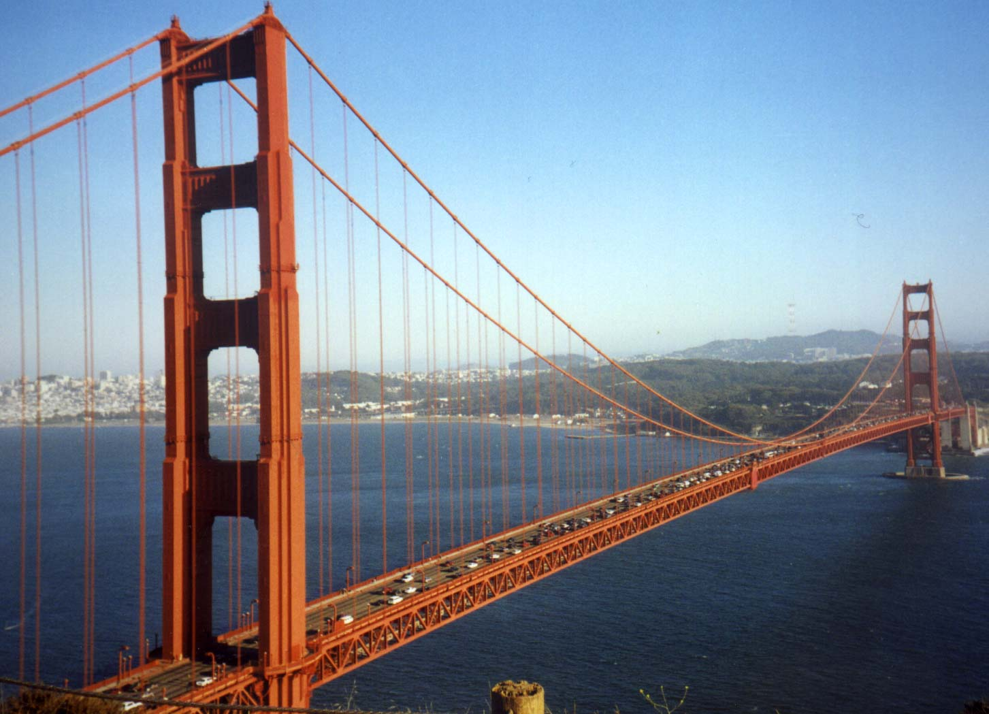
T Lymphocyte Activation, Costimulation, and Regulation
Abul K. Abbas
UCSF
FOCiS

Slide 2
Lecture outline
T cell activation
Costimulation, the B7:CD28 family
Inhibitory receptors of T cells

Slide 3
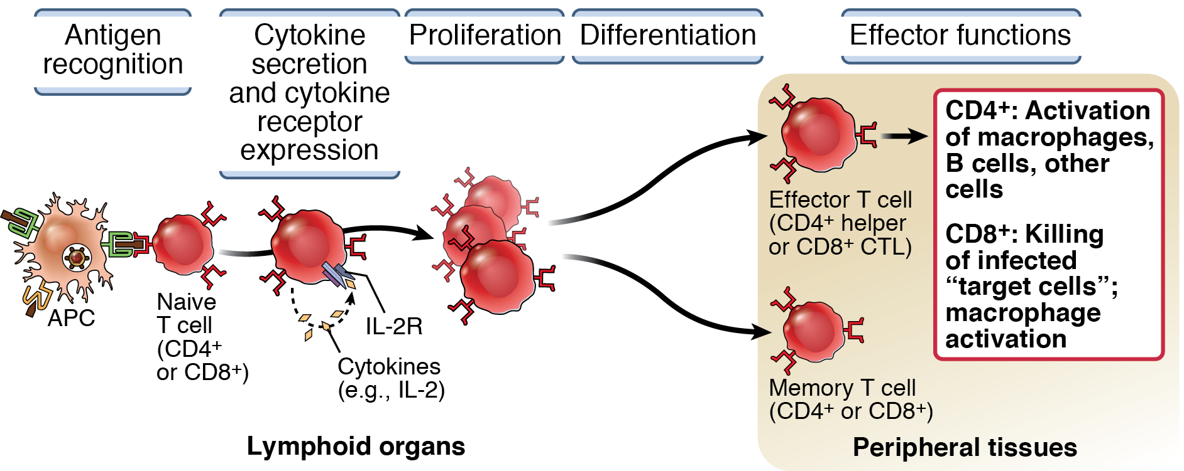
3
Steps in the activation of T lymphocytes

Slide 4
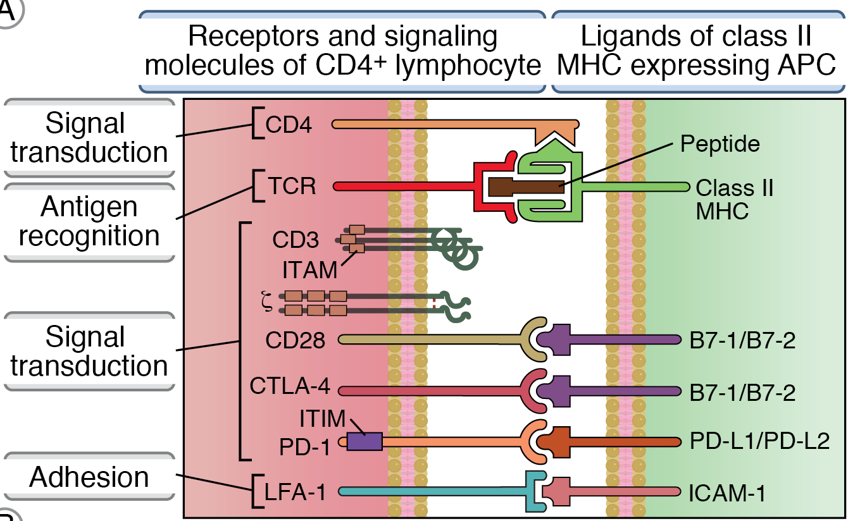
Molecules involved in T cell activation

Slide 5
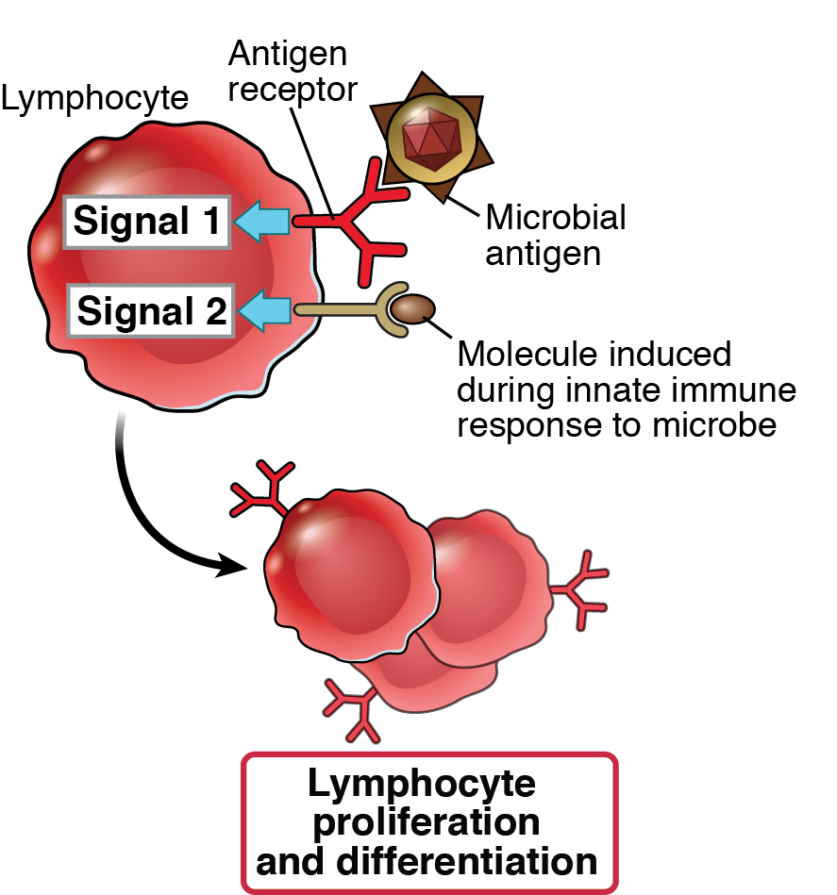
The two-signal requirement for lymphocyte activation
Second signals for T cells: “costimulators” induced on APCs by microbial products, during early innate response
Second signals for B cells: products of complement activation recognized by B cell complement receptors

Slide 6
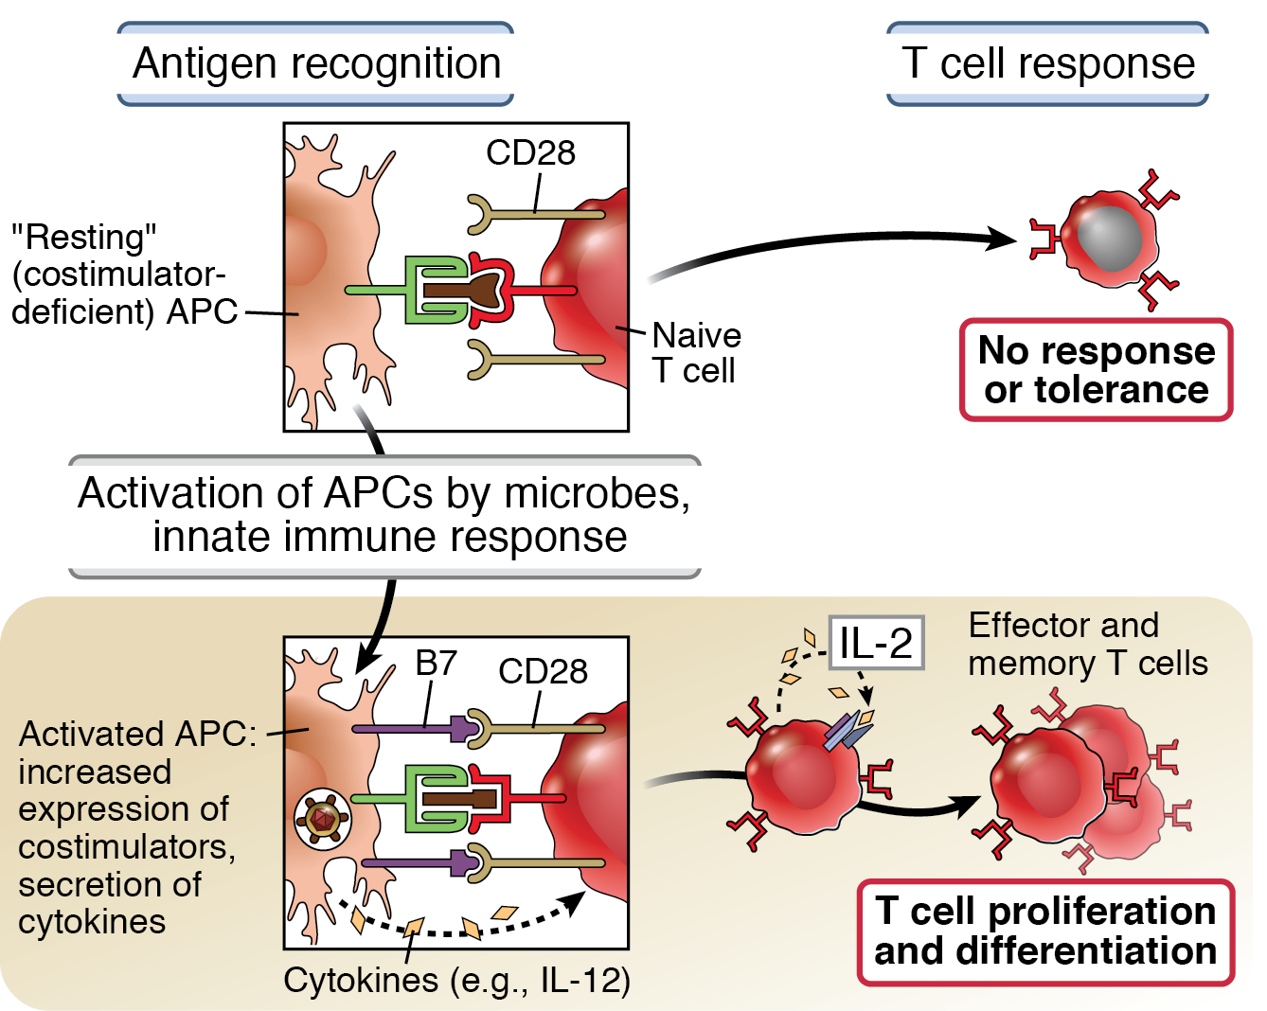
Role of costimulation in T cell activation
Abbas, Lichtman and Pillai. Basic Immunology, 5th edition, 2016
c
Elsevier

Slide 7
Costimulation
Required for initiating T cell responses (activation of naïve T cells)
Ensures that T cells respond to microbes (the inducers of costimulators) and not to harmless antigens
Source of costimulation during responses to tumors, transplants?
Targets for therapeutic blockade of T cell responses

Slide 8
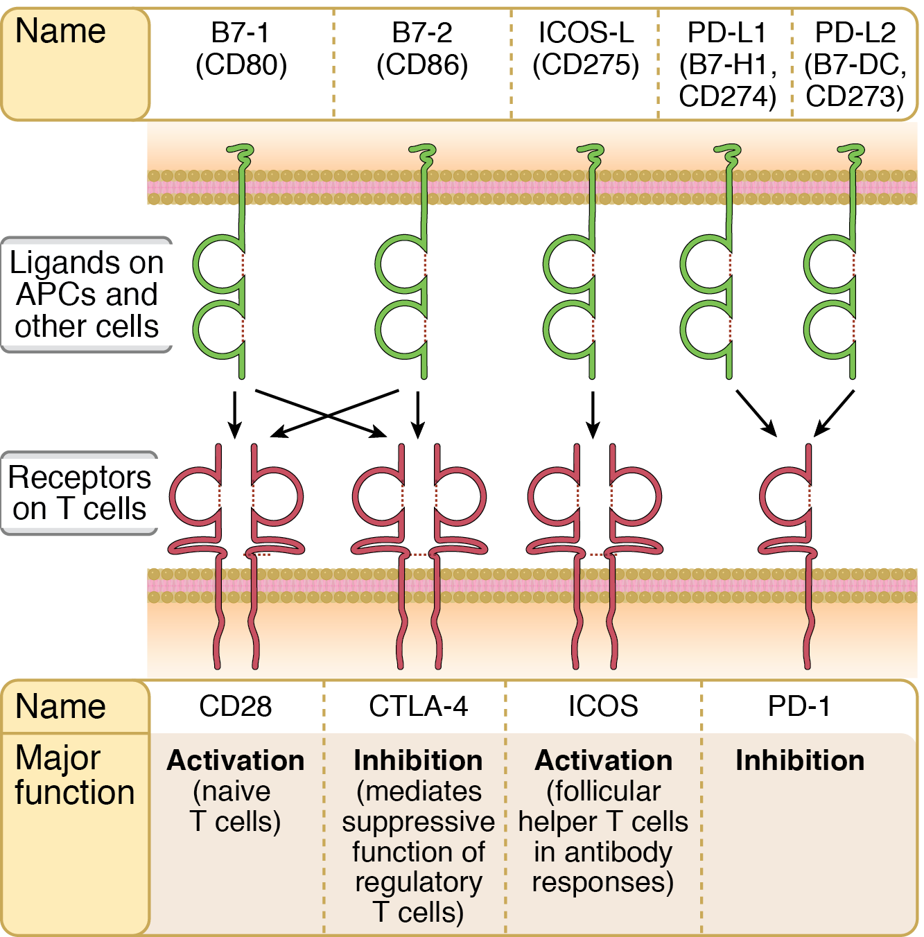
The B7:CD28 families

Slide 9
Major functions of selected CD28-B7 family members
9
CD28-B7: initiation of immune responses
ICOS-ICOS-L: T cell help in germinal center reactions (antibody responses)
CTLA-4-B7: inhibits early T cell responses in lymphoid organs
PD-1:PD-L1,2: inhibits effector T cell responses in peripheral tissues
Activation
Inhibition

Slide 10
Complexities and unknowns of B7:CD28 costimulation
Different T cell populations vary in their dependence on B7:CD28:
Naïve > activated > memory
CD4 > CD8
Regulatory T cells (controllers of immune responses) are also B7-dependent
Redundancy of B7-1 and B7-2?
Does B7 signal backwards into APCs?

Slide 11
Costimulatory blockade
CTLA4-Ig (abatacept/belatacept) is approved for rheumatoid arthritis, graft rejection

Slide 12
Inhibitory receptors of T cells
Prevent reactions against self antigens (their physiologic function)
Suppress immune responses to some tumors, chronic infections (HCV, HIV)
Therapeutic application: checkpoint blockade for cancer immunotherapy

Slide 13
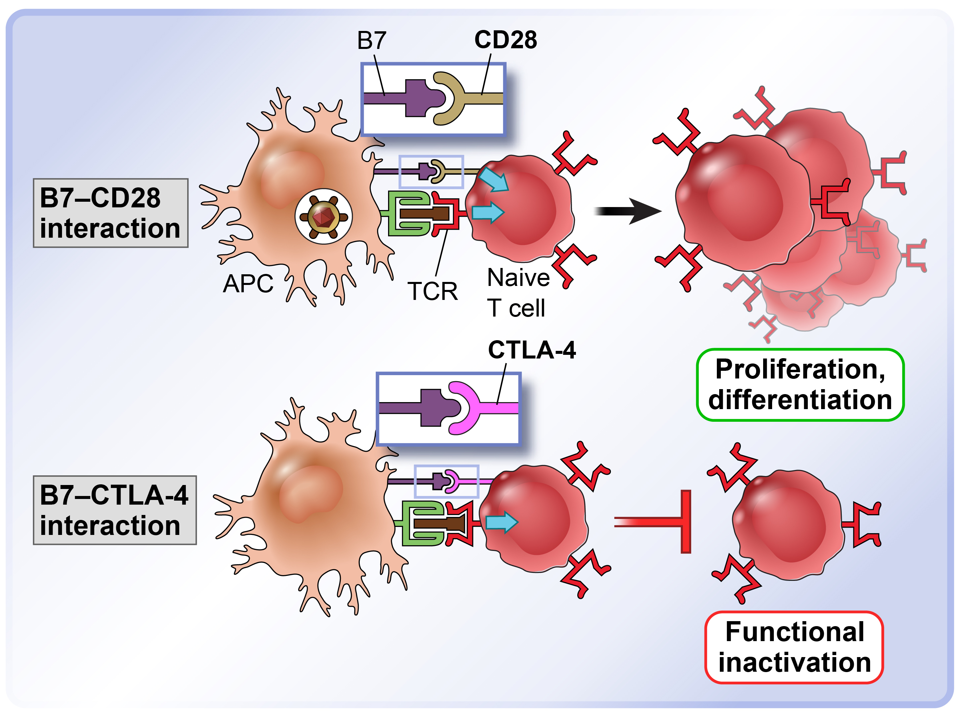
The opposing functions of CD28 and CTLA-4
Knockout of CTLA-4 in mice and mutation in humans results in immune dysregulation (lymphoproliferation, multi-organ inflammation)

Slide 14
The PD-1 inhibitory pathway
PD-1 recognizes two widely expressed ligands (PD-L1, PD-L2)
Knockout of PD-1 leads to autoimmune disease (less severe than CTLA-4-KO)
Role of PD-1 in T cell suppression in chronic infections, tumors?

Slide 15
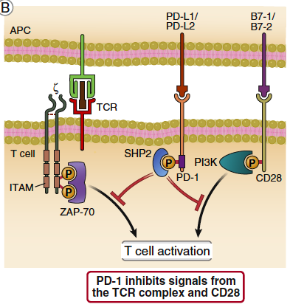
T cell activation

Slide 16
Inhibition by PD-1

Slide 17
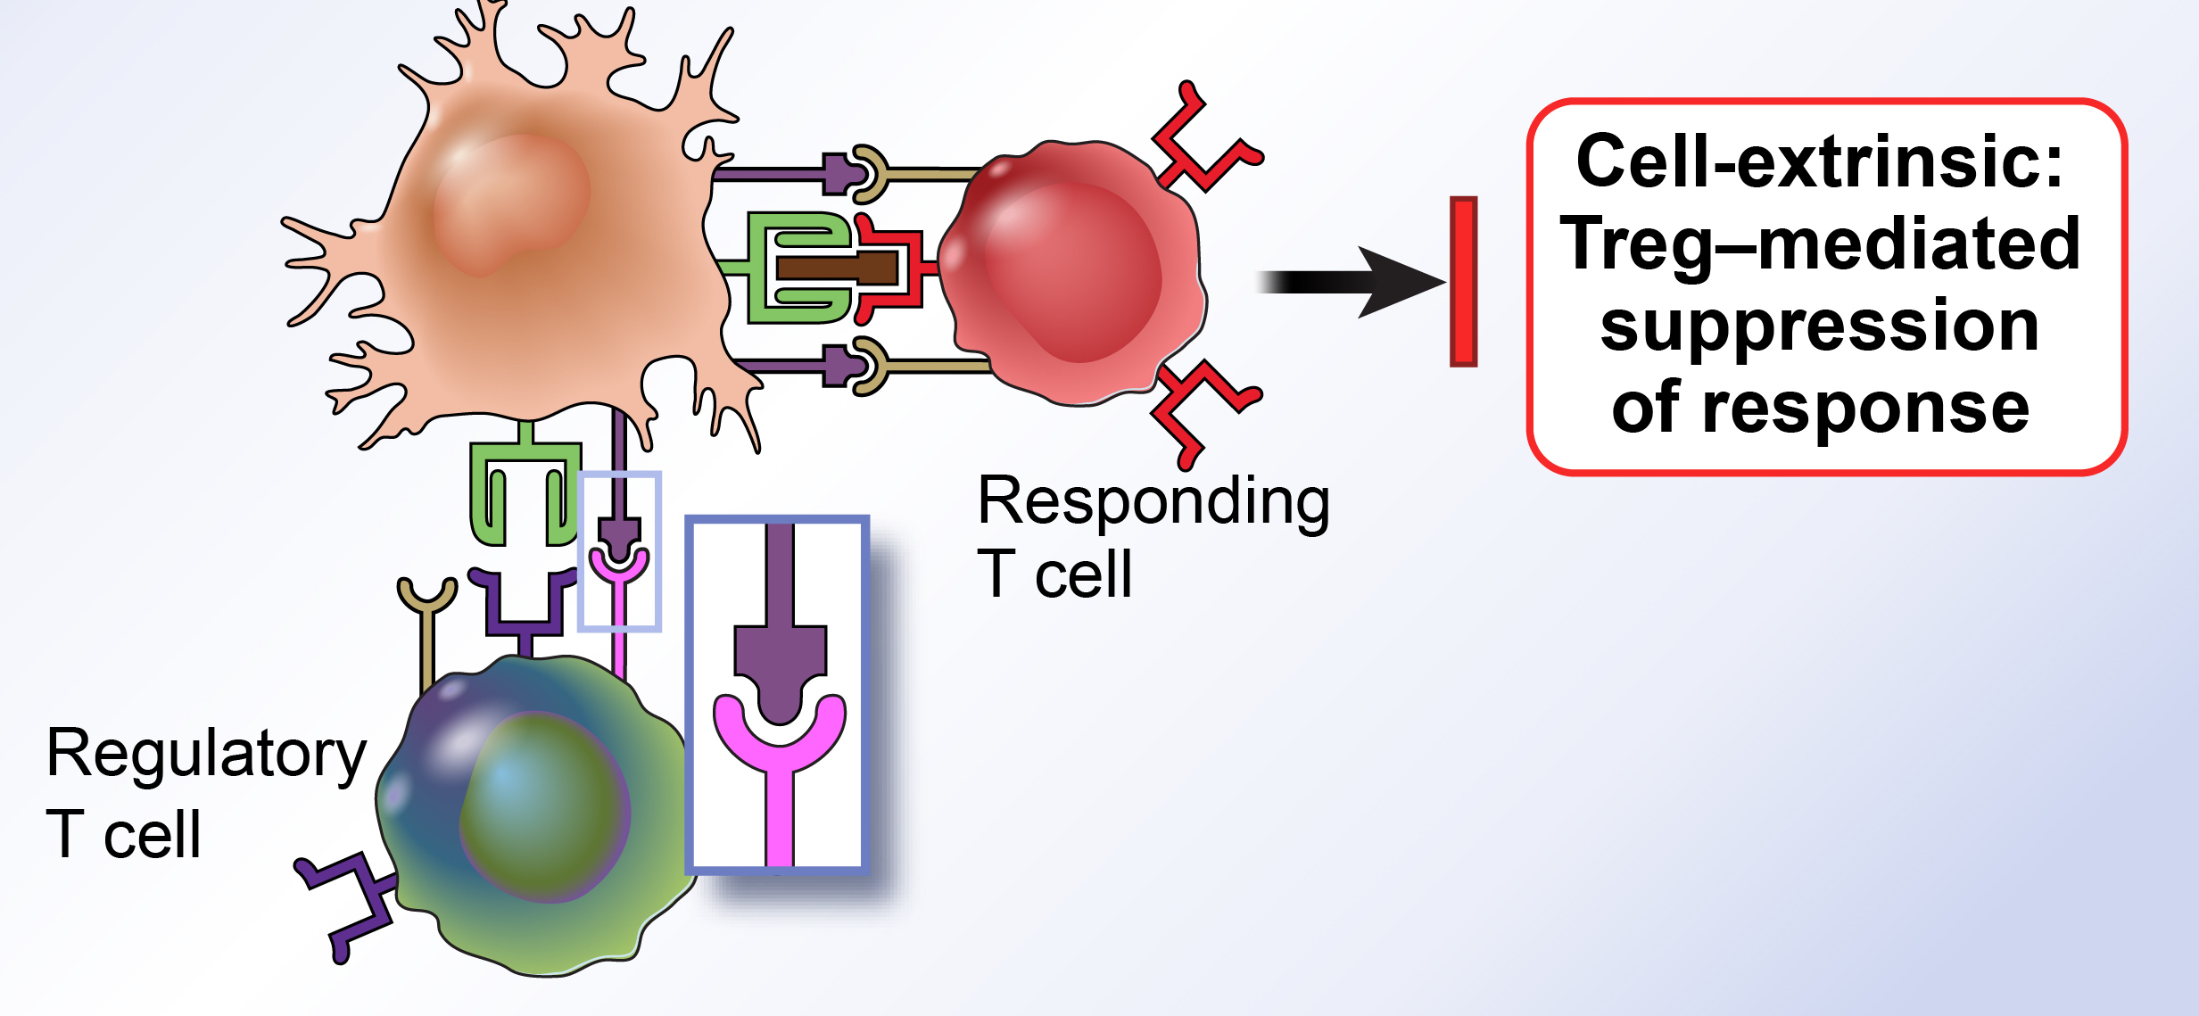
Action of CTLA-4
Transfer CTLA4- T cells into “empty” mouse → systemic inflammatory disease
Co-transfer normal (wild-type) T cells → no disease

Slide 18
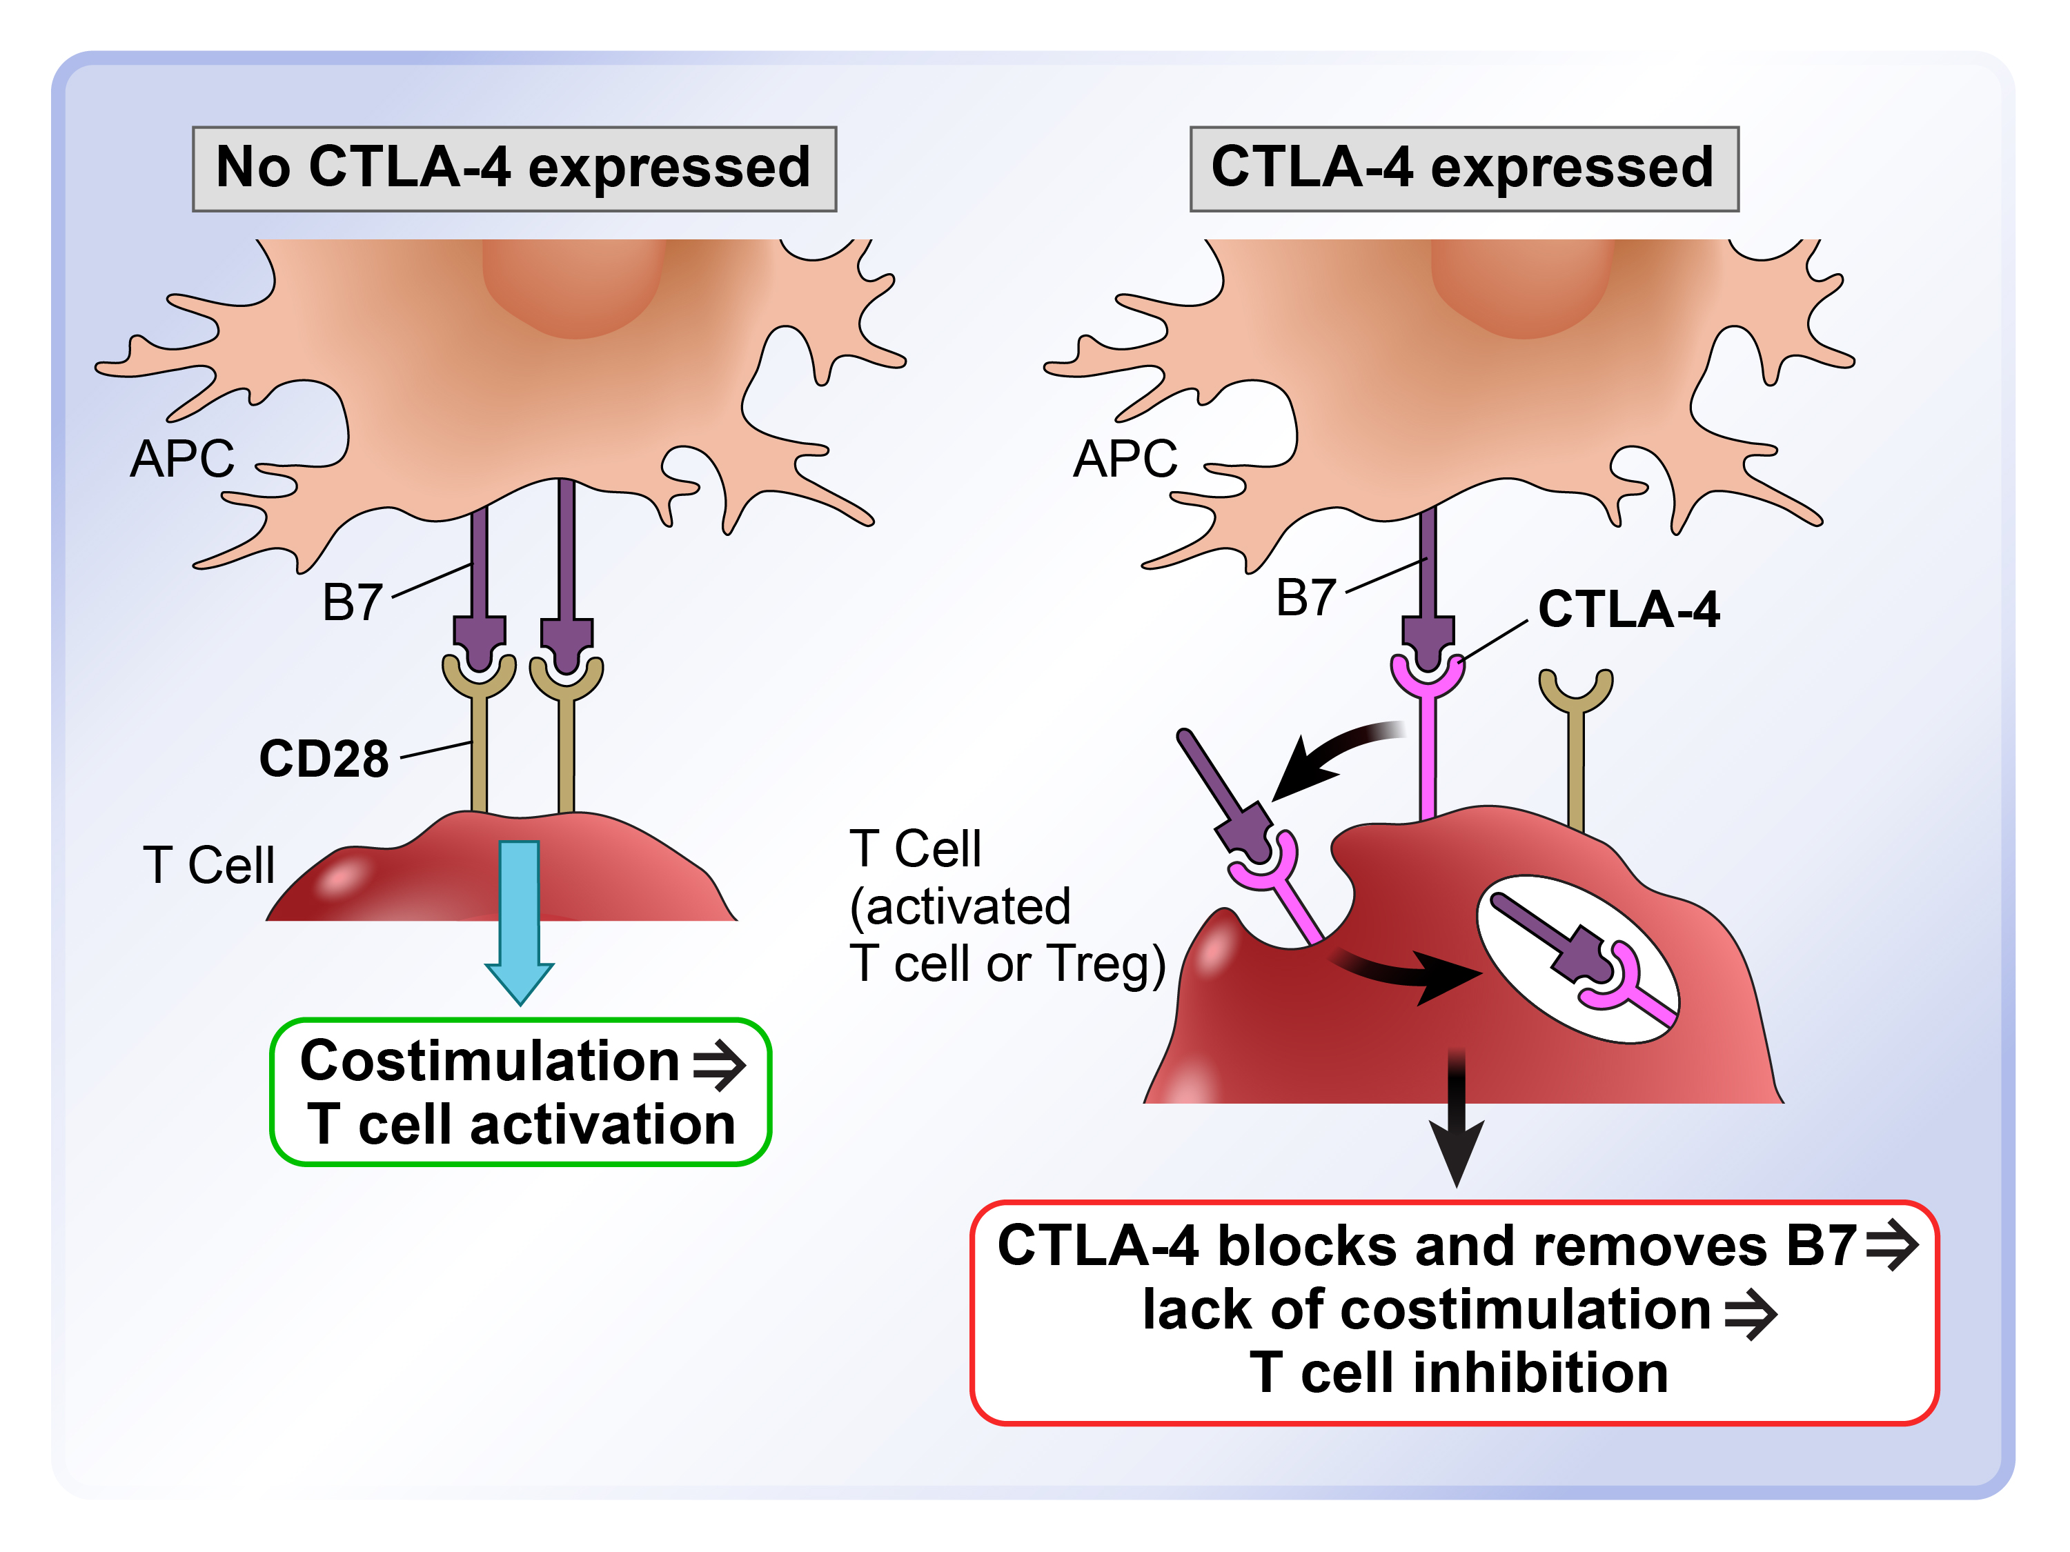
CTLA-4 competitively inhibits B7-CD28 engagement

Slide 19
CTLA-4 competitively inhibits B7-CD28 engagement

Slide 20
Functions of CTLA-4
How does a T cell choose to use CD28 to be activated (e.g. with microbes) or CTLA-4 to shut down (e.g. with self Ag)?

Slide 21
Function of CTLA-4
How does a T cell choose to use CD28 to be activated (e.g. with microbes) or CTLA-4 to shut down (e.g. with self Ag)?
Level of B7 expression and affinity of receptors: Low B7 (e.g. when DC is displaying self antigen) --> engagement of high-affinity CTLA-4; High B7 (e.g. after microbe encounter) --> engagement of lower affinity CD28

Slide 22
Consequence of mutations in the CTLA-4 pathway
APC
B7
CD28
T Cell
Unopposed costimulation →
Excessive T cell activation
Therapy?

Slide 23
Costimulators other than B7:CD28
Many proteins of the TNF-receptor family are expressed on T cells and implicated in T-cell activation and control
Functions often demonstrated in complex experimental systems or in vitro
Roles in disease (human or animal models) not definitely established
Possible therapeutic targets?

Slide 24
T cell activating and inhibitory receptors
Inhibitory receptors
Activating receptors
(costimulators)
CTLA-4
CD28
PD-1
ICOS
TIM-3
T cell
OX40
TCR
TIGIT
GITR
LAG-3
CD137 (4-1BB)
BTLA
CD27

