Slide 1
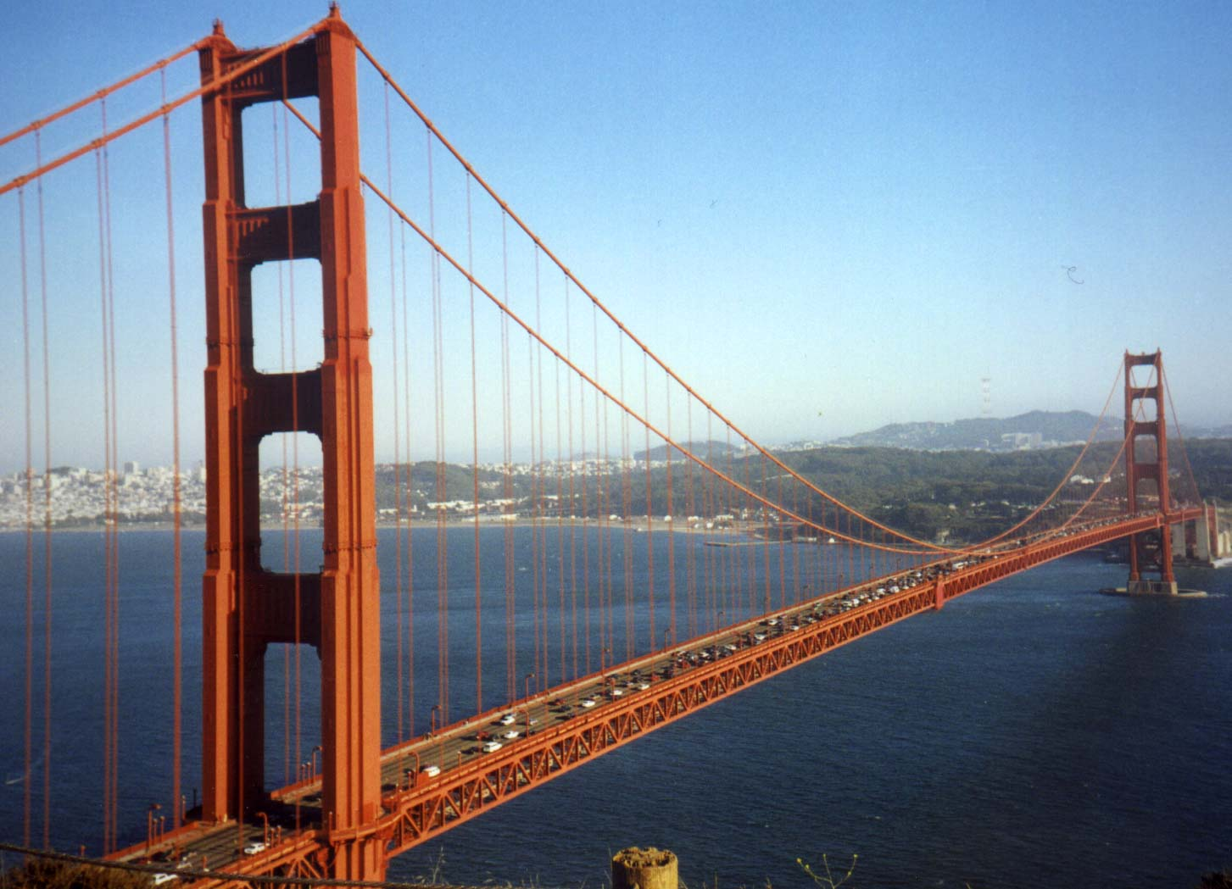
CD4 T cell subsets
Abul K. Abbas
UCSF
FOCiS

Slide 2
Lecture outline
Subsets of CD4+ T cells: definitions, functions, development
Role of T cell subsets in disease
Therapeutic strategies targeting subset-specific cytokines

Slide 3
Discovery of Th1 and Th2 subsets
Hypothesis: CD4+ T cells consist of subpopulations that mediate different types of immune responses
Identification of mouse CD4+ Th1, Th2 cells that produce distinct cytokines

Slide 4
Discovery of helper T cell subsets
4
Hypothesis: CD4+ T cells consist of subpopulations that mediate different types of immune responses
Identification of mouse CD4+ Th1, Th2 cells that produce distinct cytokines
Inflammatory diseases (mouse models) thought to be caused by Th1 cells were not prevented by eliminating Th1 cells or their cytokines
Discovery of Th17 subset

Slide 5
CD4⁺ helper T cell subsets
Defining
cytokines
Target
cells
Host
defense
Role in disease
Macrophages
Intracellular pathogens
Autoimmunity; chronic inflammation
Th1
IFN-γ
IL-12 / IFN-γ
Th2
Eosinophils
Parasites
Allergy
IL-4
IL-4
IL-5
IL-13
Th2
IL-6 / IL-1β
TGF-β
Neutrophils
Extracellular pathogens
Autoimmunity
Th17
IL-17
IL-22

Slide 6
CD4 effector T cell subsets
6
Naïve CD4
T cell
Th2
Th17
Th1
Migrate to sites of infection and inflammation
Elimination of microbes

Slide 7
CD4 effector T cell subsets
7
Naïve CD4
T cell
Th2
Th17
Th1
Follicular helper T cells (Tfh)
Migrate to sites of infection and inflammation
Remain in lymphoid organ, migrate into follicles
Help B cells to produce high-affinity antibodies
Elimination of microbes

Slide 8
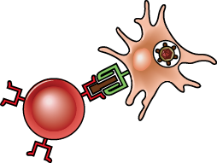
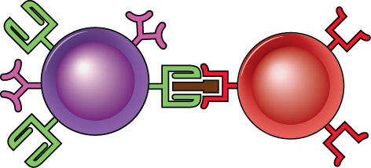
CD4⁺ T_{H} subsets
8
Defining
cytokines
Target
cells
Host
defense
Role in disease
Macrophages
Intracellular pathogens
Autoimmunity; chronic inflammation
Th1
IFN-γ
IL-12 / IFN-γ
IL-4
IL-5
IL-13
Eosinophils
Th2
Parasites
Allergy
IL-4
IL-6 / IL-1β
TGF-β
IL-17
IL-22
Neutrophils
Th17
Extracellular pathogens
Autoimmunity
B Cells
IL-21
(others)
Extracellular pathogens
Tfh
Autoimmunity

Slide 9
CD4+ T cell subsets: definitions and general properties
Populations of CD4+ T cells that make restricted and non-overlapping sets of cytokines
Early after activation, T cells can produce multiple cytokines
Progressive activation leads to “polarization”: production of selected cytokines
Distinct functions, migration properties, roles in disease

Slide 10
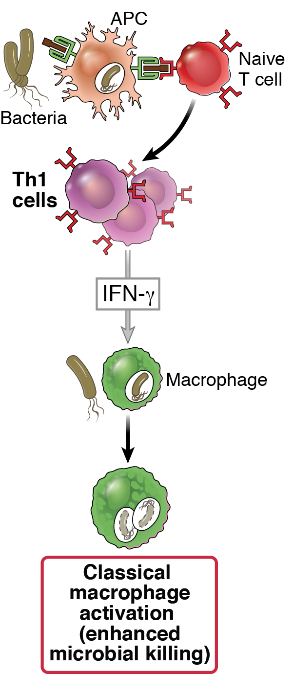
Effector functions of T_{H}1 cells:
Phagocyte-mediated host defense

Slide 11
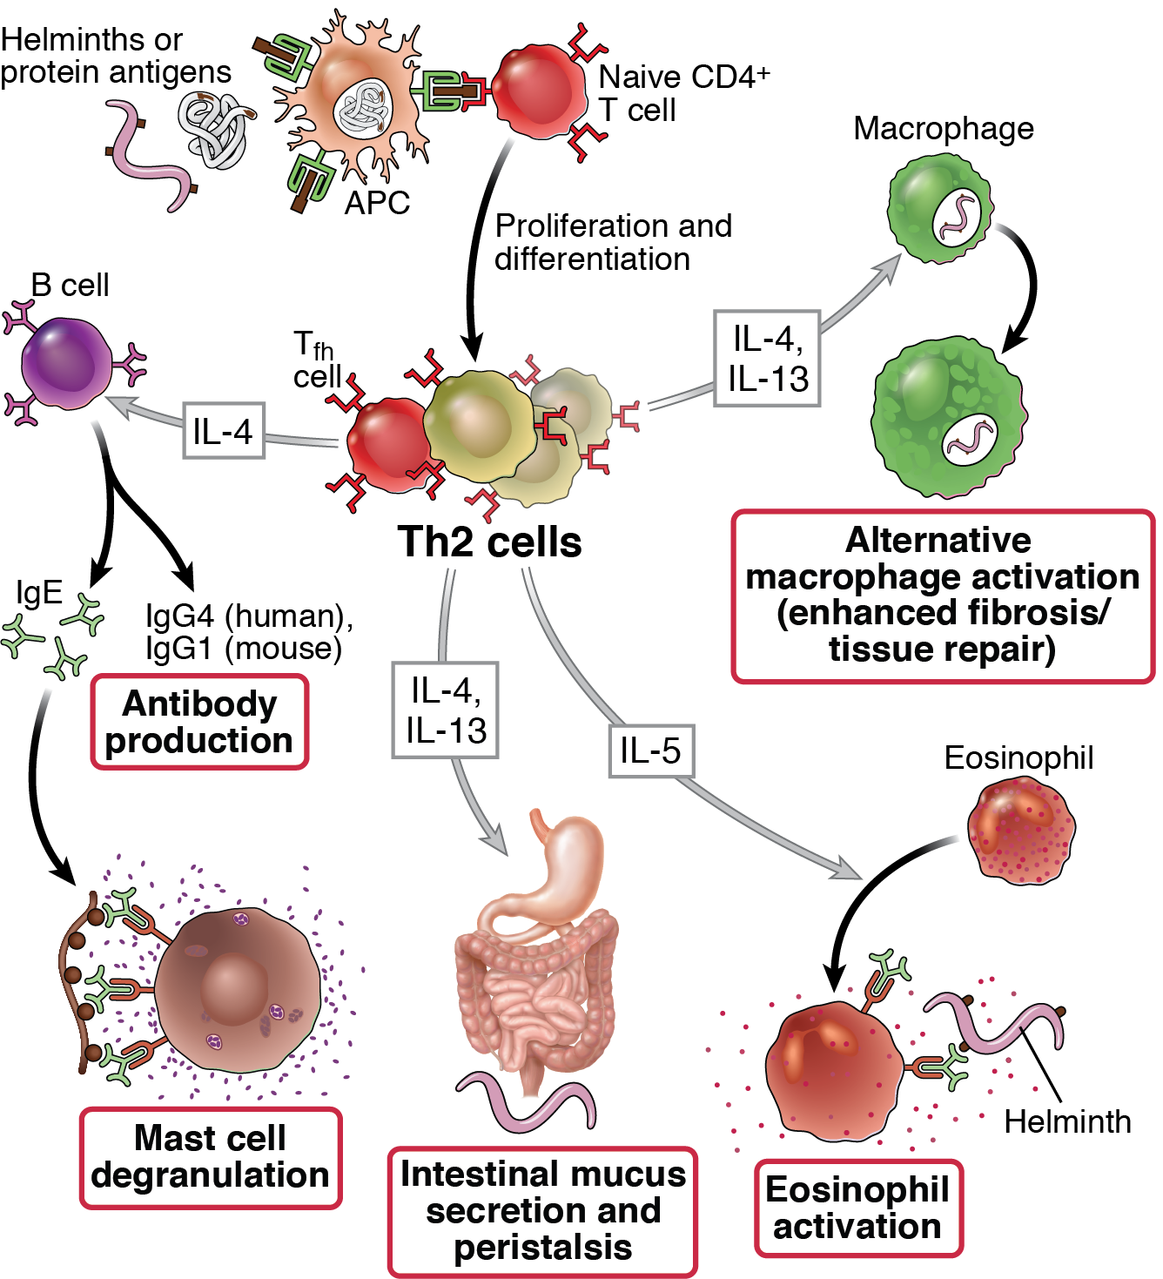
11
Effector functions of T_{H}2 cells

Slide 12
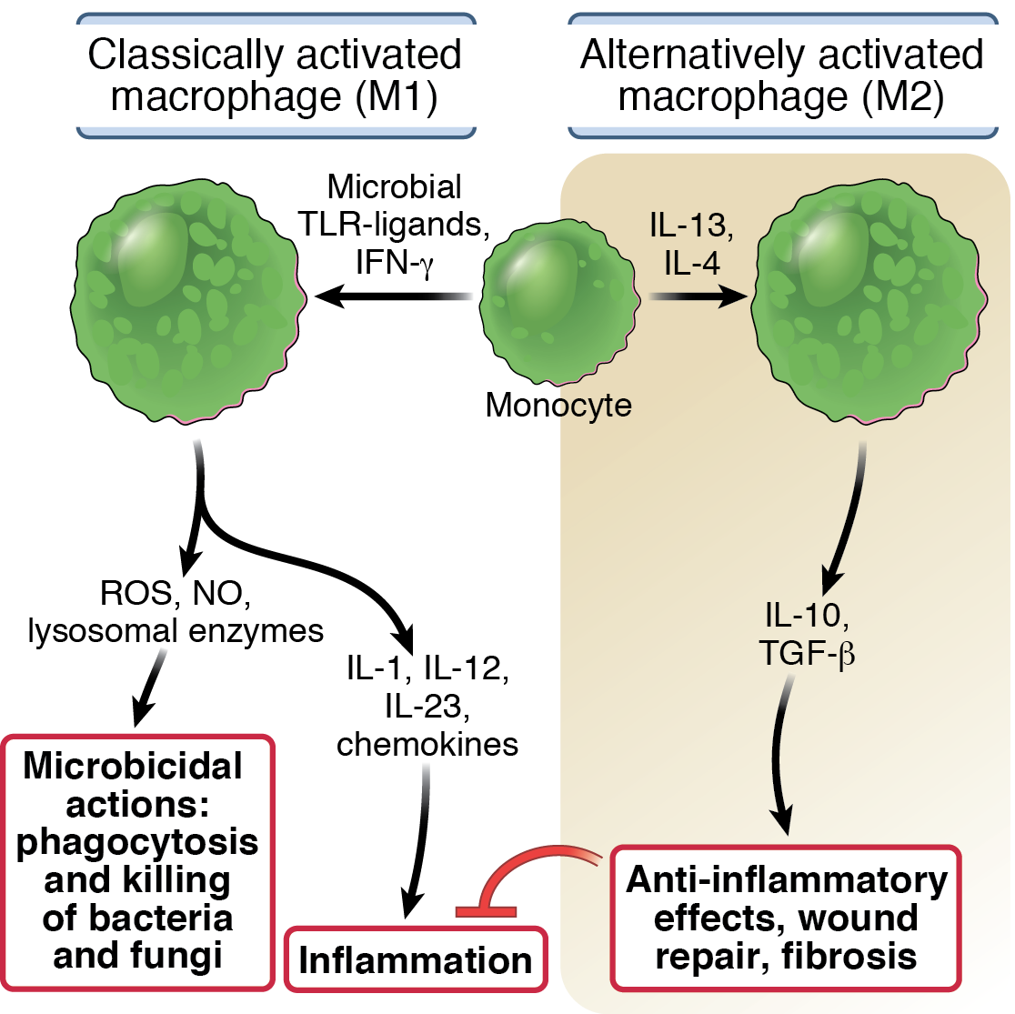
Classical and alternative macrophage activation

Slide 13
13
Classical and alternative macrophage activation
Chronic inflammation
Tumor destruction
Fibrosing disorders
Tumor promotion

Slide 14
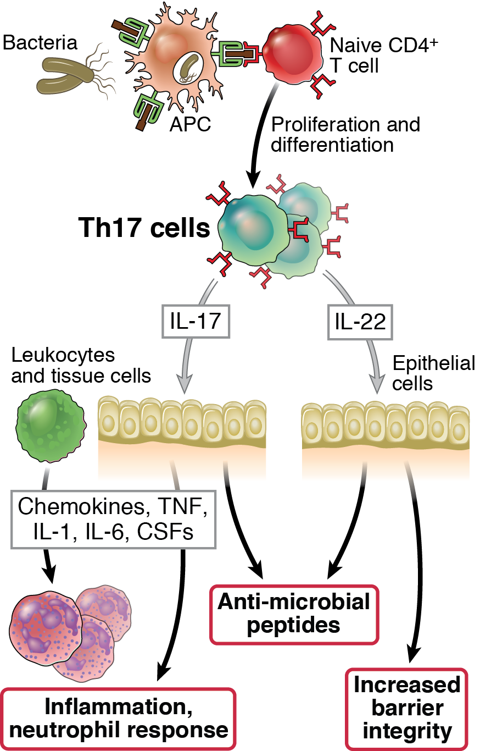
Effector functions of T_{H}17 cells

Slide 15
“Types” of immunity
Coordinated responses of ILCs (early) and Th subsets (later) in which the same sets of cytokines are produced, giving rise to the same functional outcomes
Type 1 immunity: ILC1 + Th1
Type 2 immunity: ILC2 + Th2
Type 3 immunity: ILC3 + Th17

Slide 16
Genetic proof for the importance of different T cell subsets in humans
Mutations affecting IL-12/IFN-γ cytokines or receptors → defective Th1 responses → atypical mycobacterial infections “mendelian susceptibility to mycobacterial disease”)
Mutations affecting Th17 development or IL-17 → mucocutaneous candidiasis and bacterial abscesses (“Job’s syndrome”)

Slide 17
Roles of T cell subsets in disease
Autoimmune inflammatory diseases (psoriasis, MS, RA?, IBD?): Th1 and Th17
Cytokines induce inflammation and activate neutrophils and macrophages
Allergies (e.g. asthma): Th2
Stimulation of IgE responses, activation of eosinophils
Old suggestions that some autoimmune/inflammatory diseases (SLE, ulcerative colitis) are Th2-mediated are likely incorrect

Slide 18
Therapeutic targeting of subset-specific cytokines
Antibodies that block IL-17 and IL-17R are very effective in psoriasis
May make Crohn’s disease worse
Antibody (anti-p40) that inhibits development of Th1 and Th17 cells is effective in IBD, psoriasis
Anti-IL-13 is effective in asthma patients who have a strong Th2 signature

Slide 19
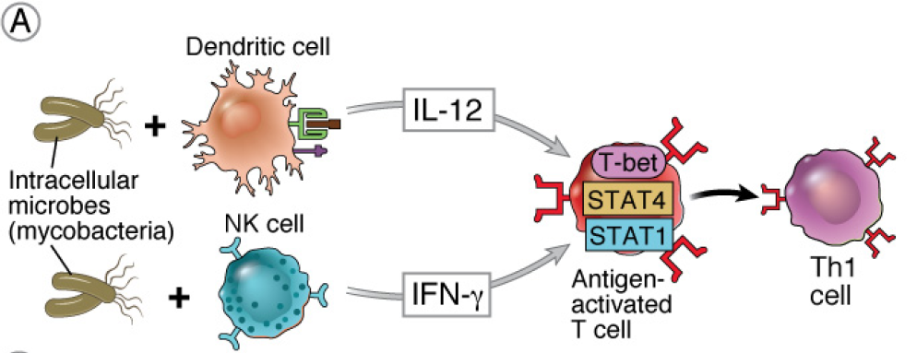
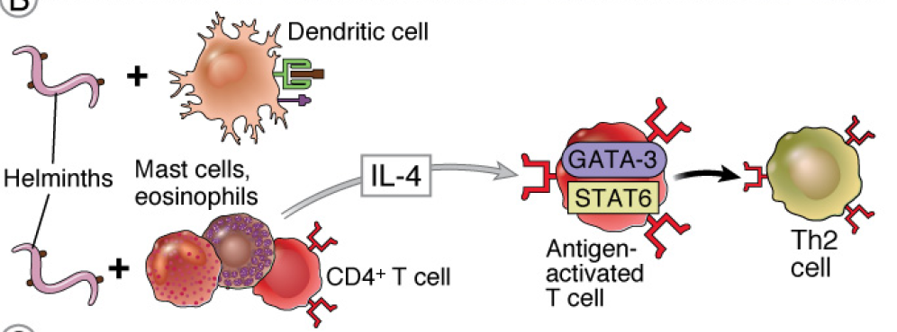
Th subset response is designed to combat different types of pathogens
Th1
Th2
Th17

Slide 20
Th subset response is designed to combat different types of pathogens
Th1
Th2
Th17

Slide 21
Th subset response is designed to combat different types of pathogens
21
Th1
Th2
Th17

Slide 22
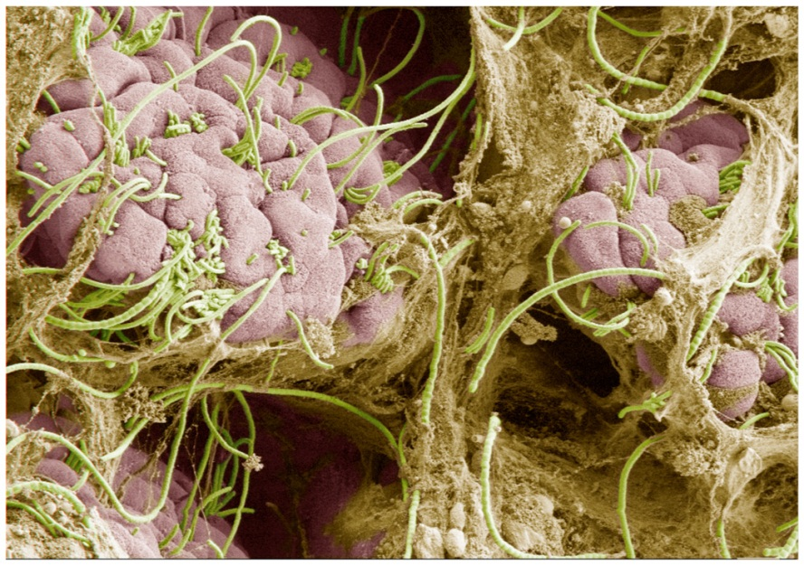
Influence of the microbiome on T cell subset development
Components of the gut flora differentially affect the proportion of functionally distinct subsets of T cells in both the intestine and other tissues.
Individual species of bacteria influence differentiation of T cell subsets, particularly Th17 cells and Treg cells.
The presence of a single species of bacteria in gut (e.g. SFB) can affect susceptibility to autoimmune disease manifest in other tissues ( e.g. joints).

Slide 23
Helper T cell subsets: unresolved questions
What is the significance of cells that produce various mixtures of cytokines or limited sets of cytokines?
Th17 cells that make IFNγ?
Th9, Th22, etc?
How stable or plastic are these subsets?
Cross-regulation of subsets: how do different populations affect one another?

Slide 24
Memory T cell heterogeneity
Central memory T cells
Live in lymphoid organs, proliferate in response to antigen → provides pool of effector cells for secondary response
Effector memory T cells
Present in tissues, rapid effector response
Tissue-resident memory T cells (Trm)
Long-lived in tissues

