Slide 1
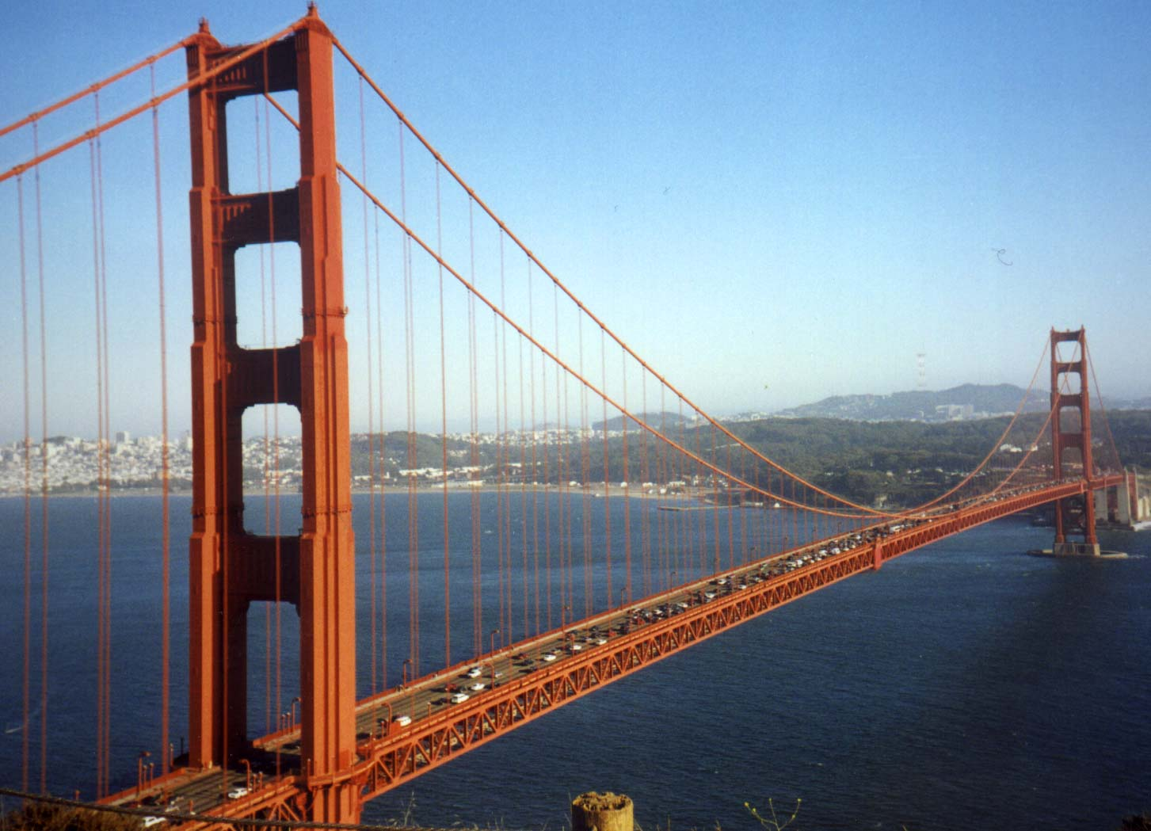
B cell activation and antibody production
Abul K. Abbas
UCSF
FOCiS

Slide 2
Lecture outline
B cell activation; the role of helper T cells in antibody production
Therapeutic targeting of B cells

Slide 3
Principles of humoral immunity
Antibodies are produced only by B lymphocytes.
Humoral immune responses are initiated by binding of antigen to membrane bound antibody on B cells.
Activated B cells secrete soluble antibodies of the same specificity as the membrane receptors.
Antibody responses are specialized and enhanced by signals from helper T cells.

Slide 4
4
The effector functions of antibodies

Slide 5
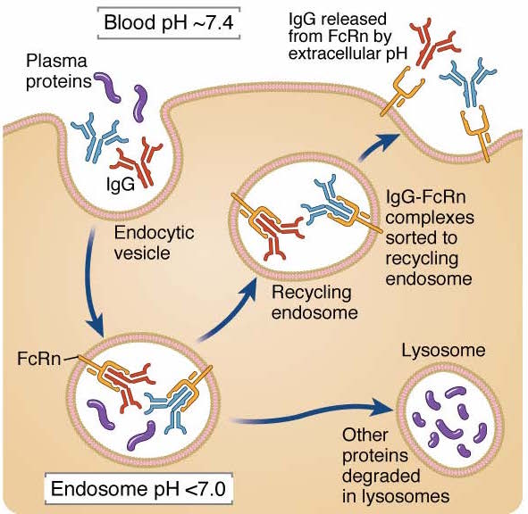
IgG recycling by “neonatal” FcR (FcRn)

Slide 6
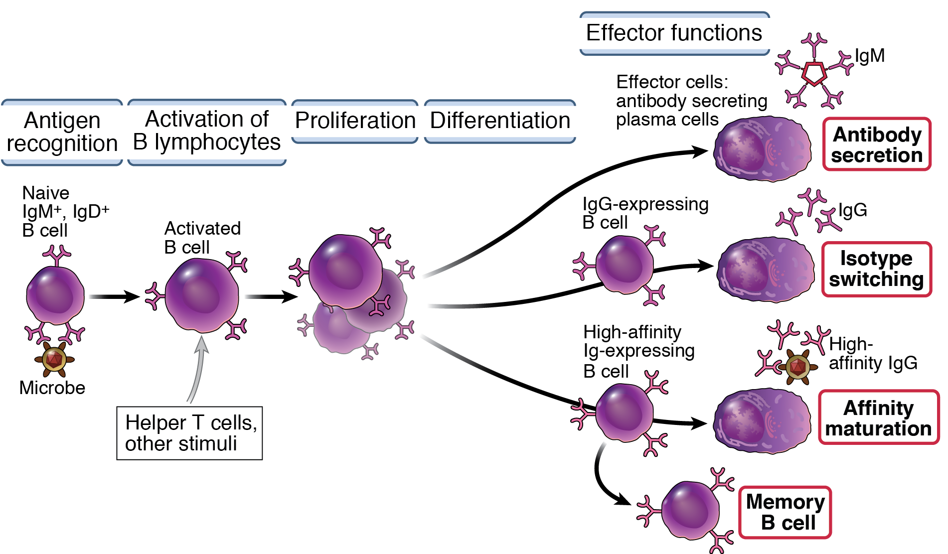
B cell activation and antibody production

Slide 7
T-independent and T-dependent antibody responses
T-independent (TI)
T-cell dependent (TD)
Ag
Ag
Ag
present
T cell
Ag
BCR
clonal expansion;
differentiation
'activation' signal
clonal expansion;
differentiation
but no clonal expansion
T-independent antigens are multivalent (e.g. bacterial polysaccharides or repeating determinants on the surface of viruses)
responses are fast (within 1-2 days) and predominantly IgM
weak in infants and young children
T-dependent antigens must contain a protein component (true of most antigens) so that T cell help can be received
responses slower (several days), produce all Ig isotypes (IgM, IgG, IgA, IgE)
stronger and can lead to antibody affinity maturation and memory

Slide 8
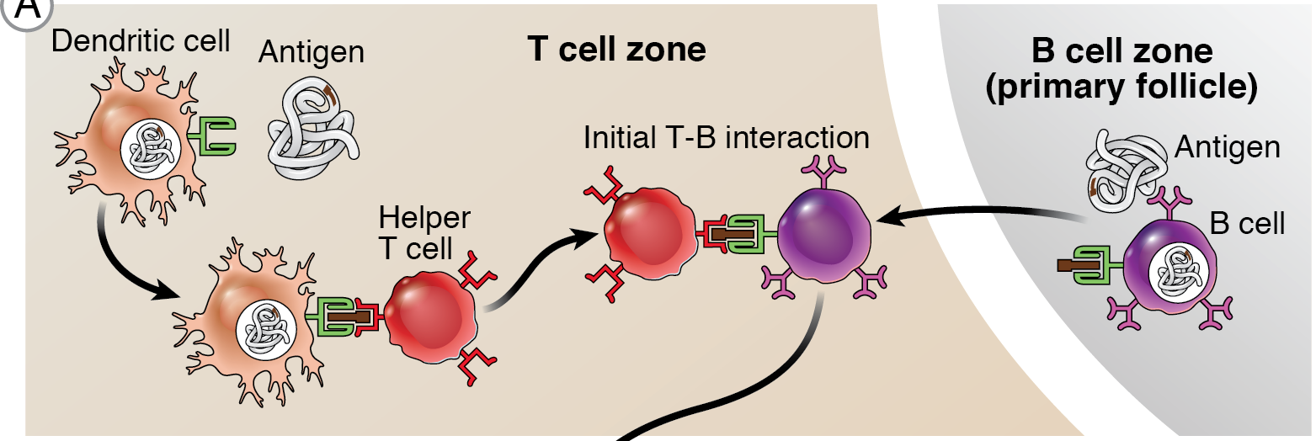
Steps in T-dependent B cell activation
Initial T-B interaction

Slide 9
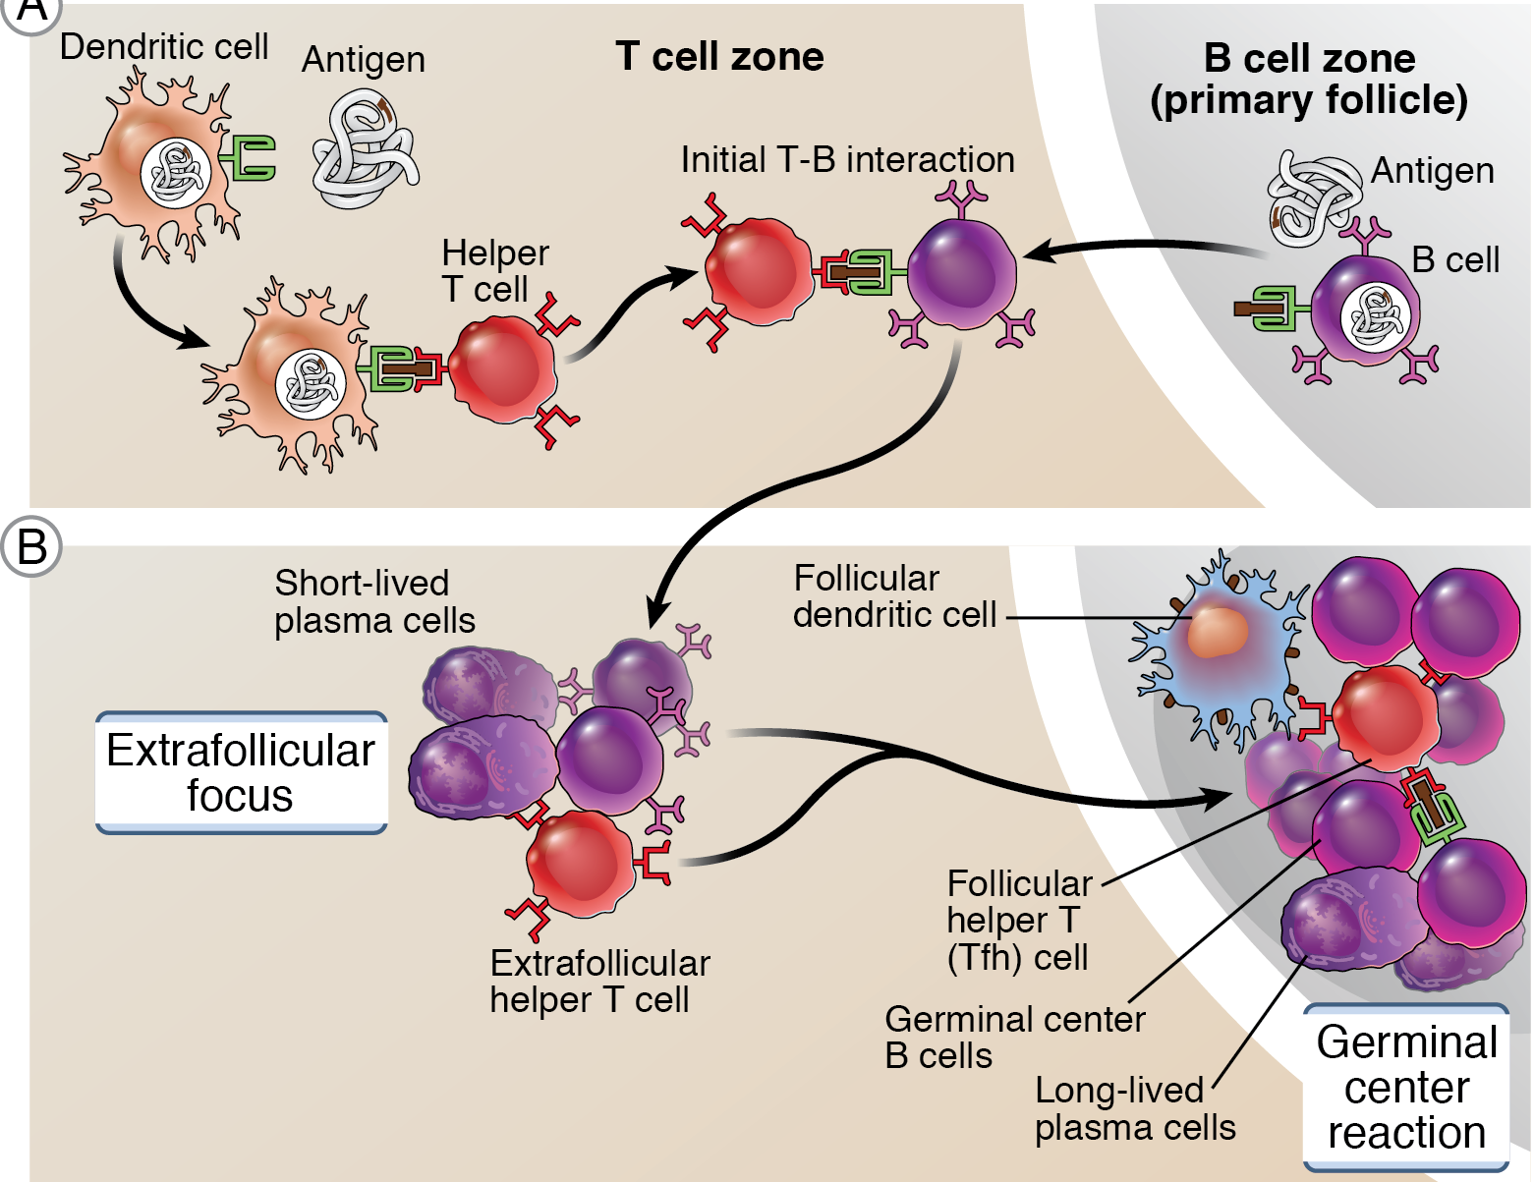
Steps in T-dependent B cell activation
Initial T-B interaction
B cell activation

Slide 10
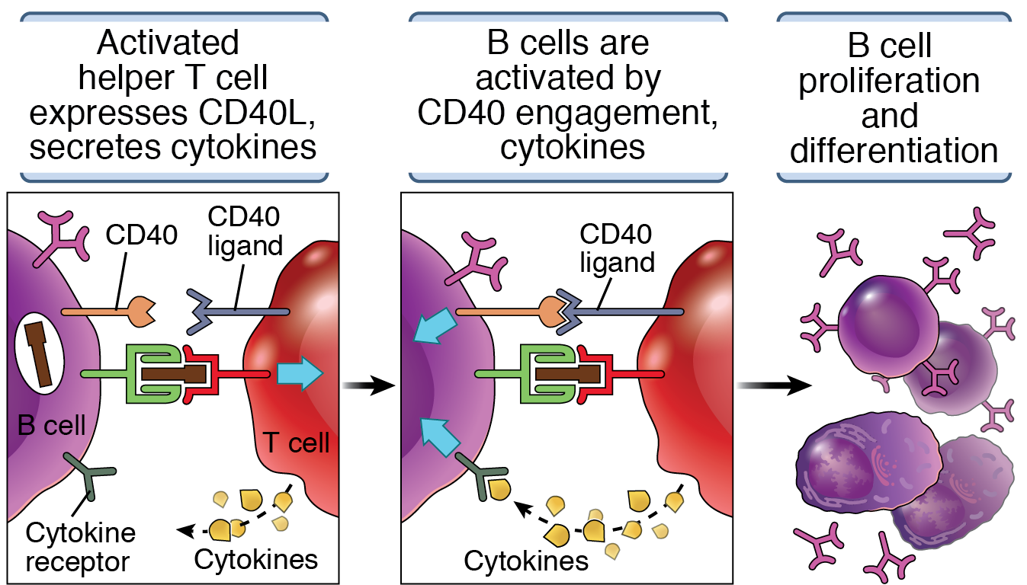
Mechanisms of helper T cell-mediated activation
of B lymphocytes
Induction of the enzyme AID

Slide 11
The germinal center reaction
Some B cells that are activated outside follicles migrate back to form germinal centers, where they undergo isotype switching and affinity maturation, and generate long-lived plasma cells and memory B cells
Driven by T cell help (follicular helper T cells)
Many of the reactions are dependent on induction of the enzyme AID in B cells

Slide 12
TFH cells: a unique helper T cell subset
Naïve CD4
T cell
IL-12
IFN-γ
ICOS
IL-6?
IL-1
IL-6
IL-23
Follicular helper T (Tfh) cells
IL-4
Tbet
STAT1
STAT4
GATA3
STAT6
RORγt
STAT3
BCL-6
BCL-6
Th1
Th2
IL-21 +
Th17
IFN-γ
IL-4
IL-5
IL-13
IFN-γ
IL-4
IL-13?
IL-17

Slide 13
Follicular helper T cells (Tfh)
Some effector T cells express the chemokine receptor CXCR5, migrate to lymphoid follicles, and help B cells (isotype switching, affinity maturation)
Characteristics of Tfh:
Surface CXCR5, ICOS
Transcription factor: BCL-6
Cytokines secreted: IL-21 + IL-4 or IFNγ (or IL-17?)

Slide 14
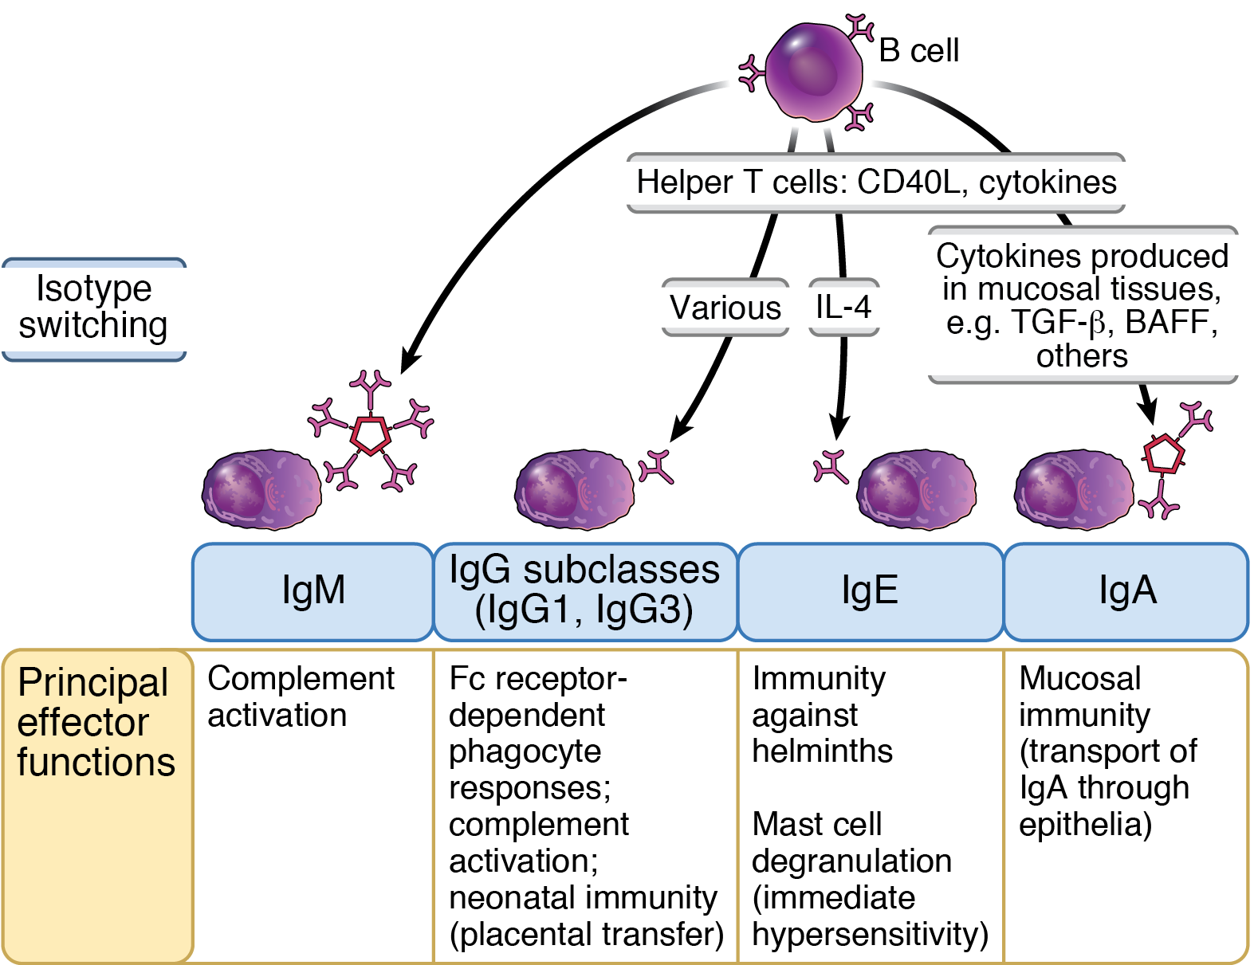
Immunoglobulin (Ig) heavy chain isotype (class) switching

Slide 15
Ig Heavy chain class (isotype) switching
IgG+
memory
cell
IgM+ naive
B cell
IgG
secreting
plasma cell
variable
constant
VDJ
μ
γ
ε
α
55 kb
AID = Activation Induced Deaminase
T cell help
(cytokines, CD40L)

Slide 16
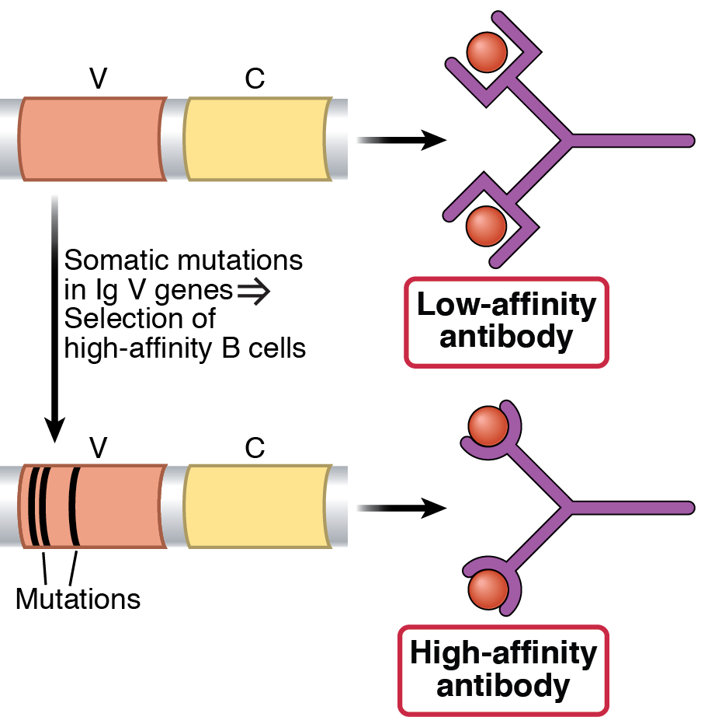
Affinity maturation of antibodies
Early antibody response
Response to repeated stimulation with protein antigens

Slide 17
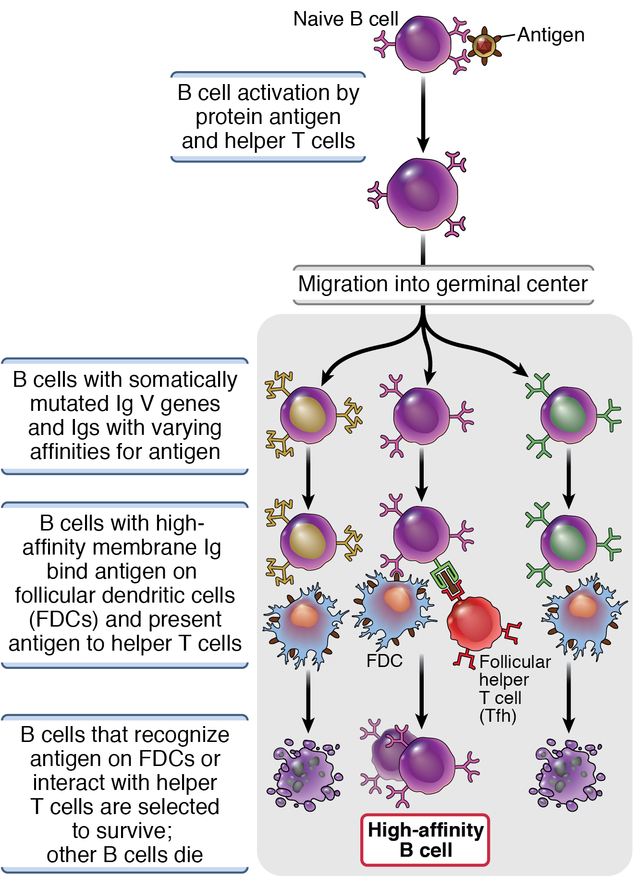
“Darwinian” selection of the “fittest” high-affinity B cells in germinal centers

Slide 18
Plasma cells
Following immunization, serum antibody is detectable for a long time but there are no plasma cells in lymph nodes or spleen
Who is making the antibody and where?

Slide 19
Plasma cells
Following immunization, serum antibody is detectable for a long time but there are no plasma cells in lymph nodes or spleen
Who is making the antibody and where?
Plasma cells generated during GC reaction migrate to bone marrow (and mucosal tissues) and survive for years, producing antibody
Much of circulating IgG is produced by long-lived plasma cells, provides initial protection

Slide 20
The germinal center reaction
Site of development of sophisticated antibody responses
Isotype switching, affinity maturation, long-lived plasma cells, memory B cells
Driven by follicular helper T cells (assays for blood Tfh cells in humans?)
Need to maximize the reaction for development of effective vaccines
Does dysregulation of the GC reaction contribute to autoimmune diseases?
Strong autoantibody responses
Generation of self-reactive B cells?

Slide 21
21
Therapeutic strategies targeting antibody producing cells
IVIg (does it act on B cells?)
B cell depletion: anti-CD20 antibody
BAFF antagonists
Anti-CD40, CD40L (trials)
Depletion of plasma cells: bortezomib (proteasome inhibitor)
Plasmapheresis (in severe cases of autoimmunity)

